Slide 1
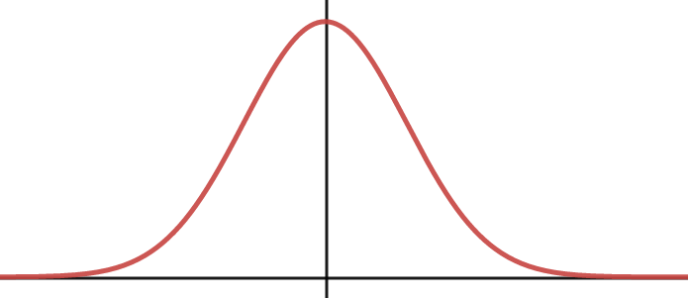
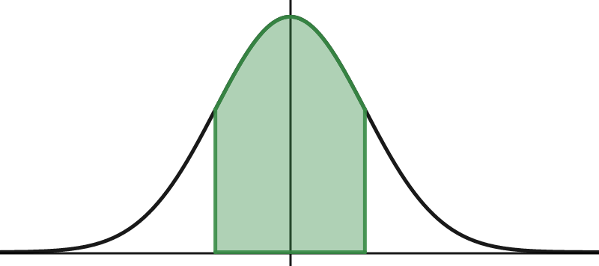
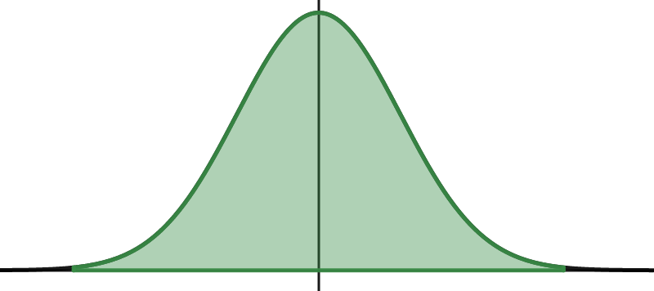

Normal Distribution Revision
Paper 2: Sample Means
Quality Assurance
Normal distribution
NORMAL DISTRIBUTION CONDITIONS
NOTATION
SHAPE
DISTRIBUTION OF DATA

Slide 2
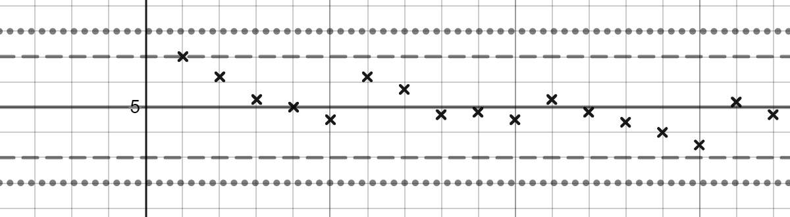
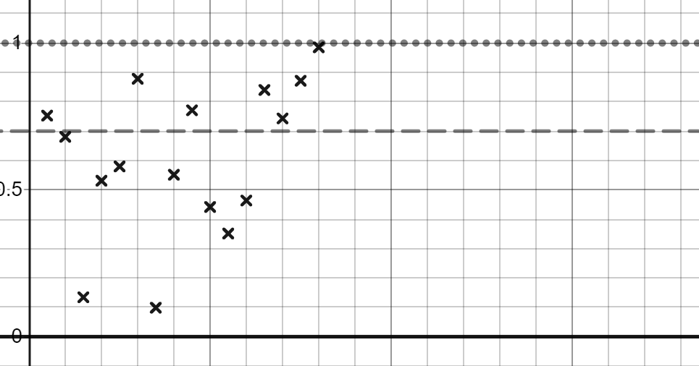
STANDARDISED SCORE
SAMPLE MEAN DISTRIBUTION
QUALITY ASSURANCE
MEAN CONTROL CHART
QUALITY ASSURANCE
RANGE CONTROL CHART

Slide 3
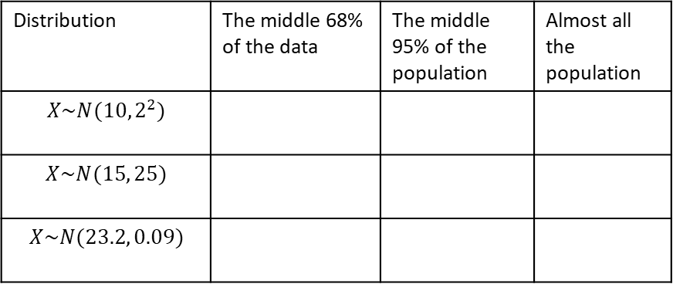
1
For each of the following Normal distributions fill in the table for the range of values for which you find:
The middle 68% of the population
The middle 95% of the population
Almost all the population
Distribution | The middle 68% of the data | The middle 95% of the population | Almost all the population
$$X\sim N(10, 2^{2})$$
$$X\sim N(15, 25)$$
$$X\sim N(23.2, 0.09)$$
2
Calculate the standardised scores for the following:
Mean | Standard Deviation | Score | Standardised Score
10 | 2 | 6
0.2 | 0.01 | 0.225
6 | 1.5 | 6.2

Slide 4
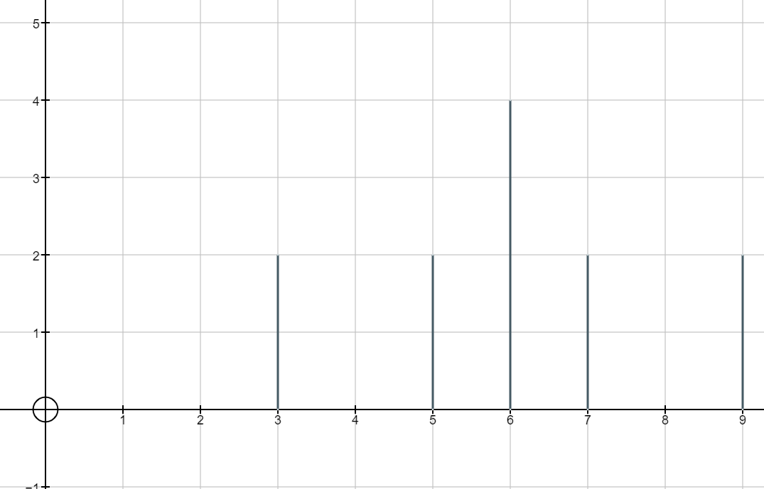
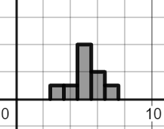
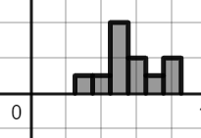
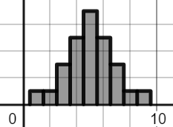
3
Which of these can be modelled by a Normal distribution?
Data | Mean | Median | Mode | Distribution Shape
Discrete | 6 | 6 | 6
Continuous | 5 | 5 | 5
Continuous | 5.6 | 5 | 5
Continuous | 5 | 5 | 5

Slide 5
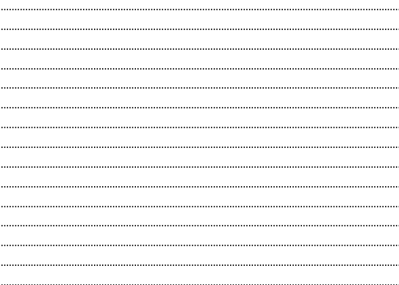
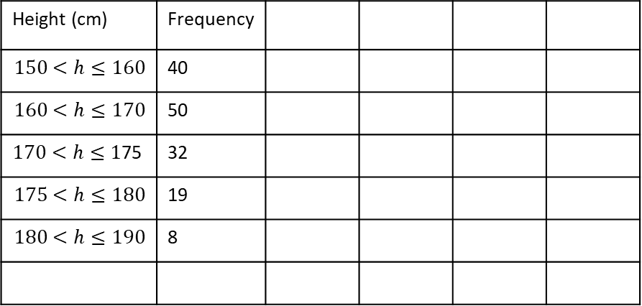
3
Calculate the mean and standard deviation for the data set below
Height (cm) | Frequency
$$150<h≤160$$ | 40
$$160<h≤170$$ | 50
$170<h≤1$75 | 32
$$175<h≤180$$ | 19
$$180<h≤190$$ | 8
By approximating the number of people with in 1 standard deviation, 2 standard deviations and 3 standard deviations of the mean explain if the normal distribution could be used to model this data.

Slide 6
4
Mason and Ellie are taking part in the parkrun.
They want to compare their times.
Below are the mean and standard deviations for their age group and their finish times.
Explain who is the better runner.
Name | Time | Mean for age group | Standard deviation for age group
Ellie | 32 minutes 40 secs | 30 minutes | 7 minutes 30 secs
Mason | 29 minutes 18 secs | 28 minutes | 6 minutes 45 seconds

Slide 7
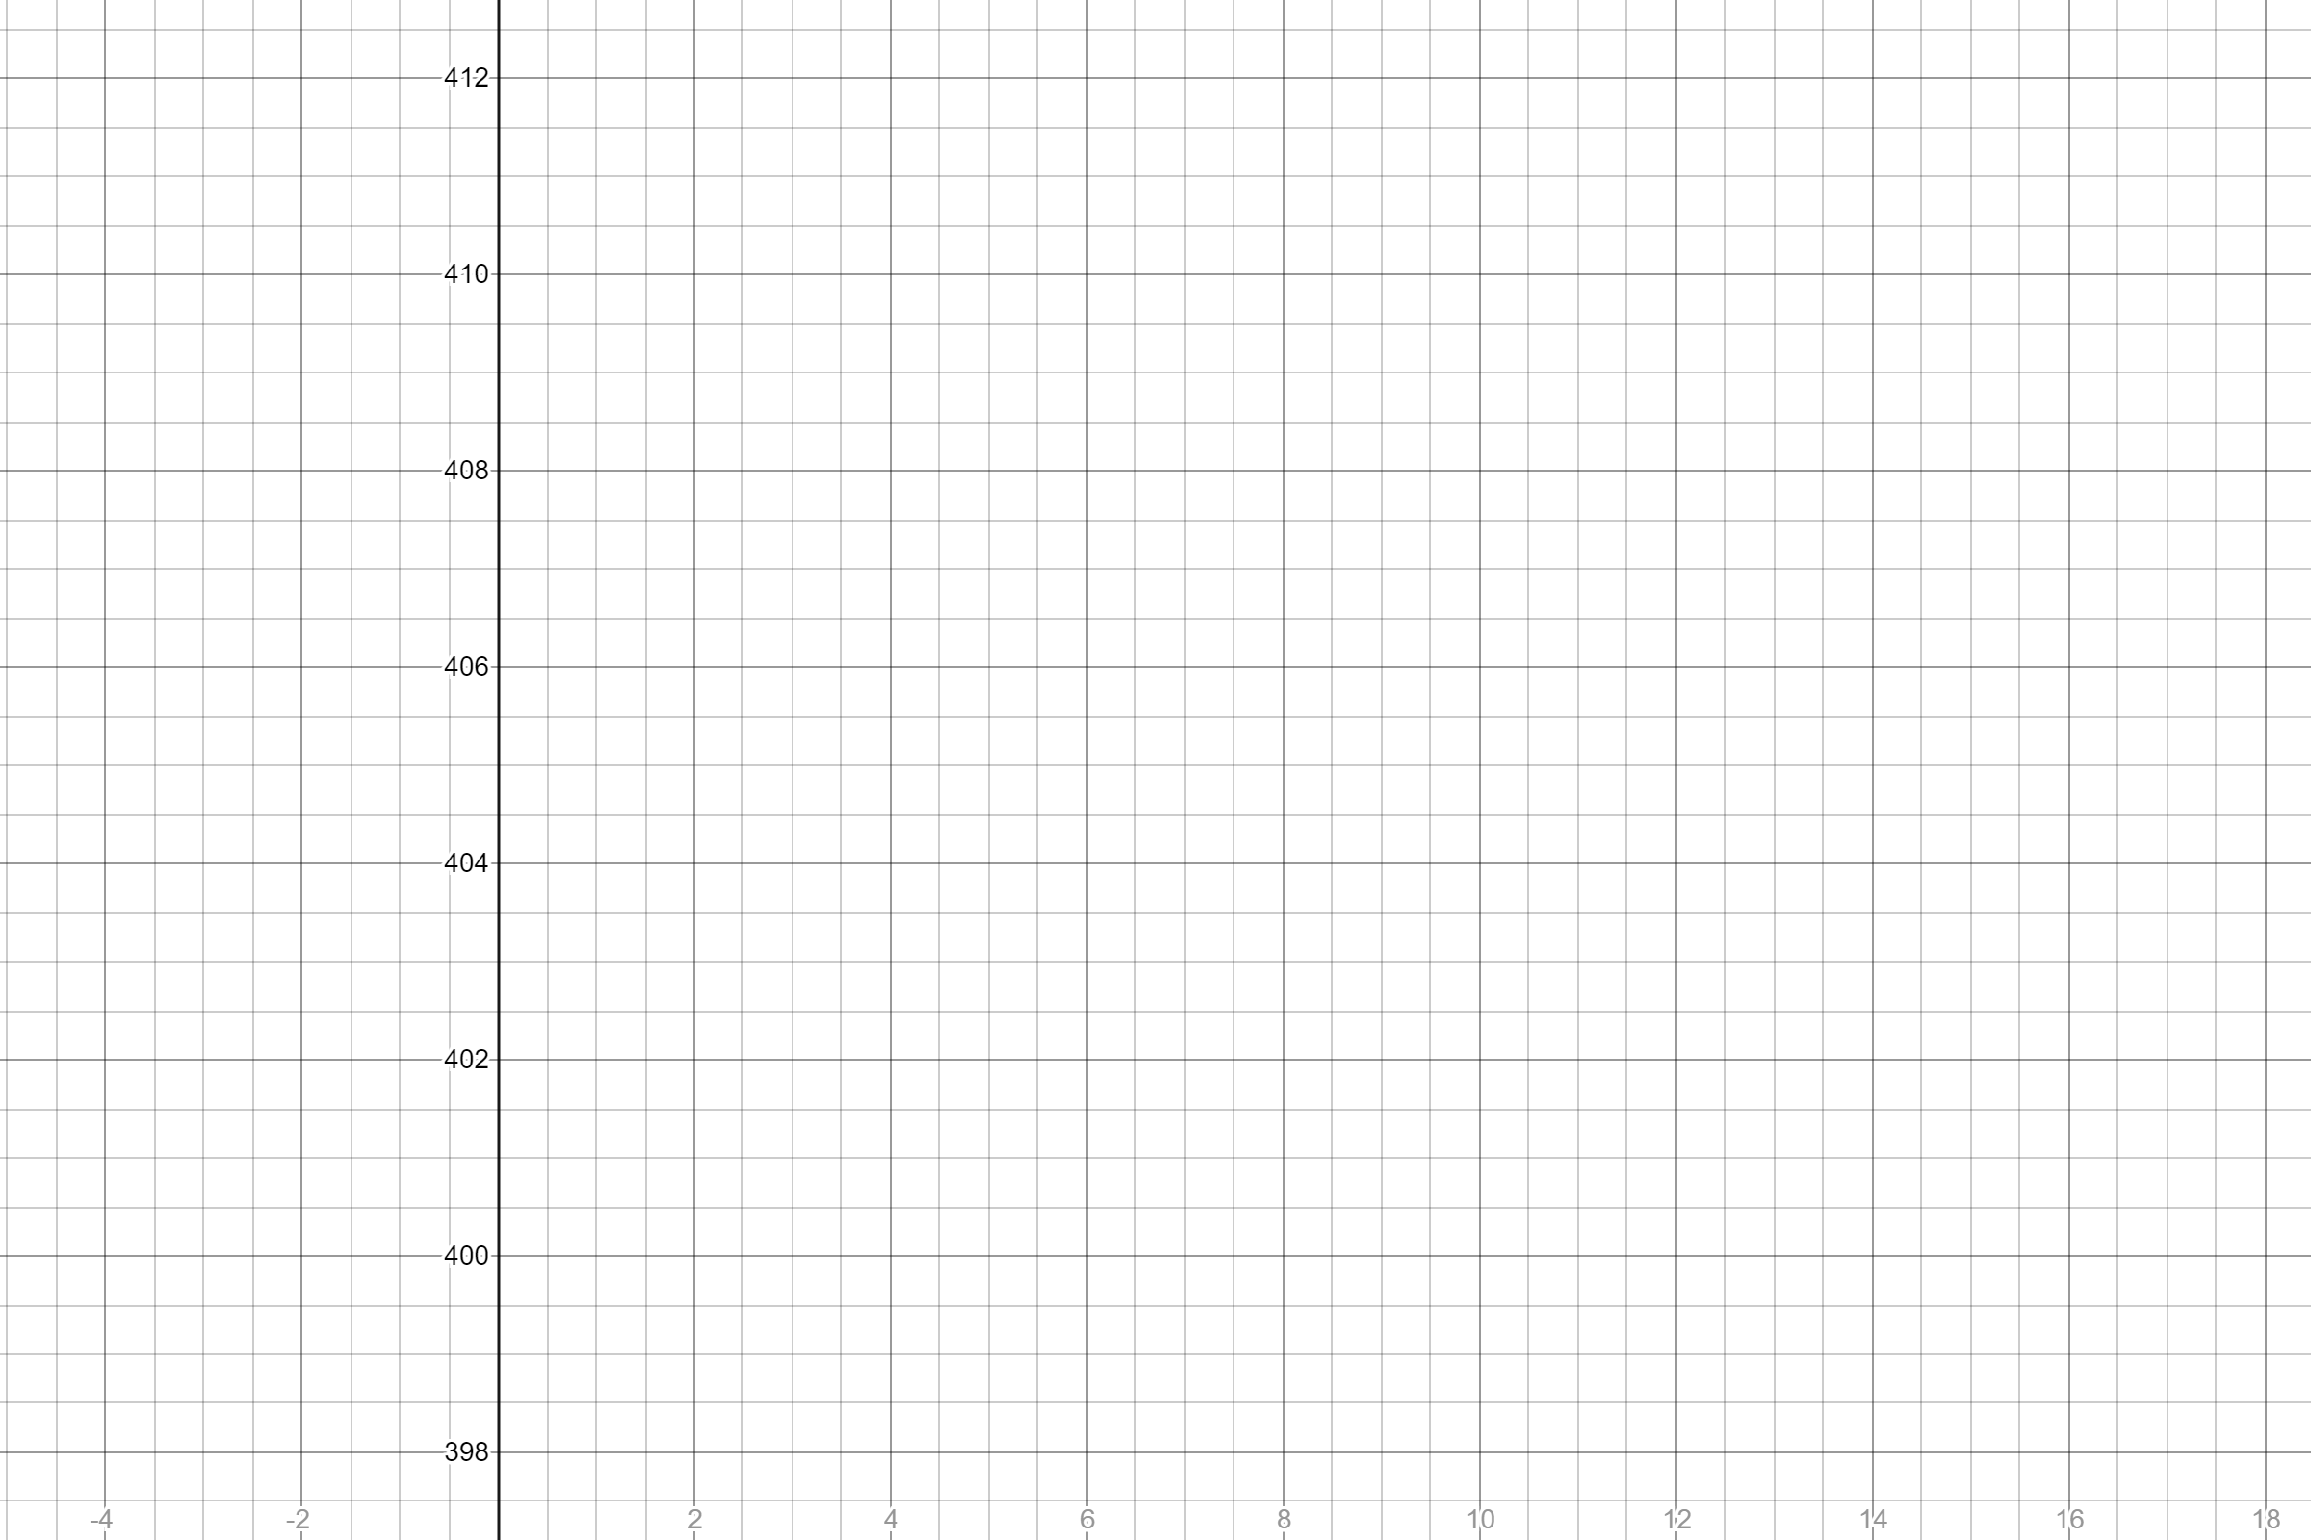
5
Complete the following sentences.
The population mean is ……………………………………………the mean of the sample means
The population standard deviation is ………………………………………………….the standard deviation of the sample means
6
A factory is producing cans of baked beans.
The filling process is set so that the average weight of the can after it has been filled is 405g, and the standard deviation is 1.5 g.
Draw the action and warning lines on this control chart.

Slide 8
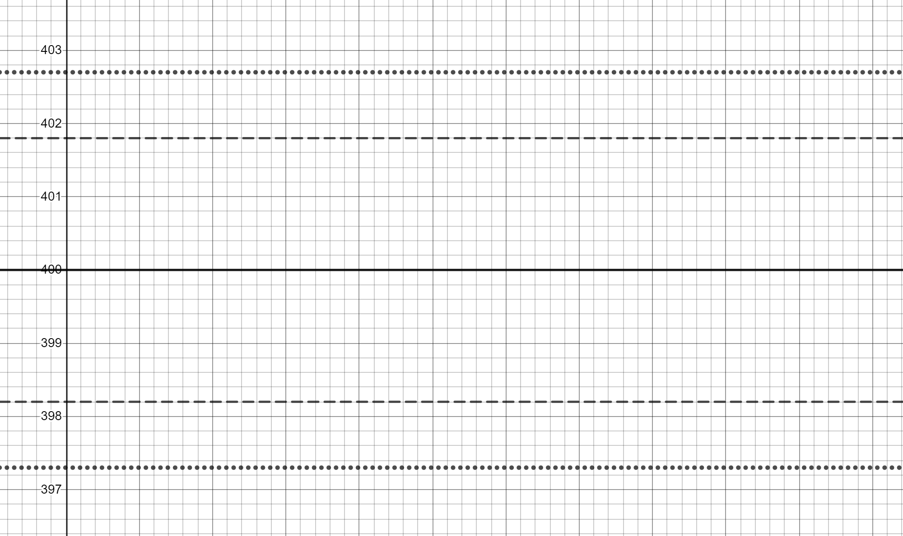
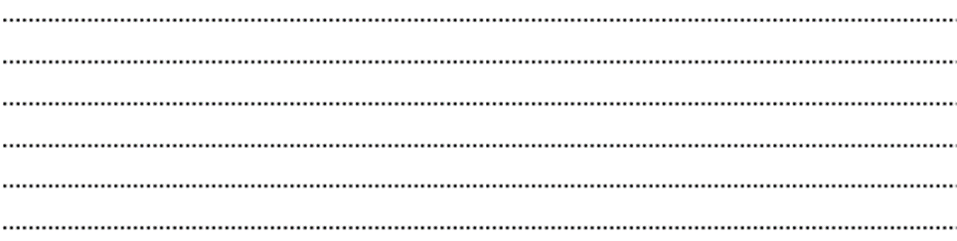
7
Below is a mean control chart for a different canning machine in the same factory.
A sample of 10 cans is taken and the mean is calculated as 402.3g.
Explain what action is taken.

Slide 9
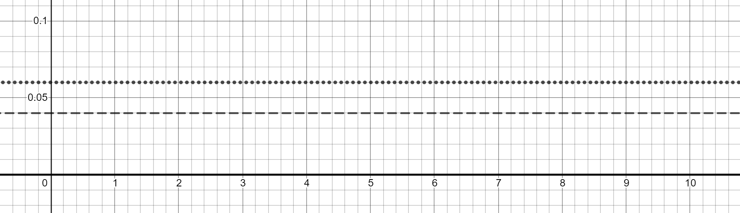
8
Below is a range control chart for a machine which produces 10mm nails.
Explain in context what each of the action and warning lines are on the chart.
Explain why there are no lower action and warning lines

